Slide 1

Bijan Paul
Senior Lecturer
East West University
Notes:
Anyone already familiar with HTML?
Disclaimer: I do not work in HTML very often.

Slide 2
Setting the style of an HTML element, can be done with the style attribute.
The HTML style attribute has the following syntax:
<tagname style="property:value;">
The property is a CSS property. The value is a CSS value.
The background-color property defines the background color for an HTML element.
The color property defines the text color for an HTML element.
The font-family property defines the font to be used for an HTML element.
The font-size property defines the text size for an HTML element.
The text-align property defines the horizontal text alignment for an HTML element.

Slide 3
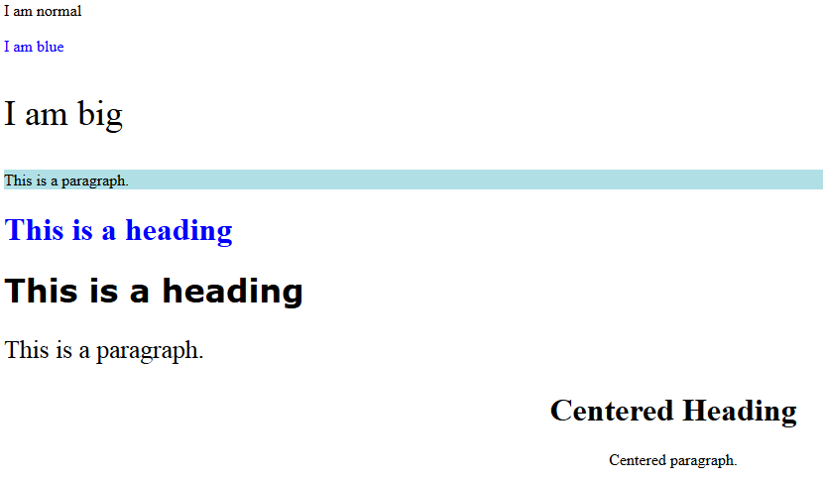
<!DOCTYPE html>
<html>
<body>
<p>I am normal</p>
<p style="color:blue;">I am blue</p>
<p style="font-size:36px;">I am big</p>
<p style="background-color:powderblue;">This is a paragraph.</p>
<h1 style="color:blue;">This is a heading</h1>
<h1 style="font-family:verdana;">This is a heading</h1>
<p style="font-size:160%;">This is a paragraph.</p>
<h1 style="text-align:center;">Centered Heading</h1>
<p style="text-align:center;">Centered paragraph.</p>
</body>
</html>

Slide 4
HTML also defines special elements for defining text with a special meaning.
HTML uses elements like <b> and <i> for formatting output, like bold or italic text.
Formatting elements were designed to display special types of text:
    <b> - Bold text
    <strong> - Important text
    <i> - Italic text
    <em> - Emphasized text
    <mark> - Marked text
    <small> - Small text
    <del> - Deleted text
    <ins> - Inserted text
    <sub> - Subscript text
    <sup> - Superscript text

Slide 5
<b> element defines bold text, without any extra importance.
<strong> element defines strong text, with added semantic "strong" importance.
<i> element defines italic text, without any extra importance.
<em> element defines emphasized text, with added semantic importance.
<small> element defines smaller text
<mark> element defines marked or highlighted text
<del> element defines deleted (removed) text
<ins> element defines inserted (added) text
<sub> element defines _{subscripted} text.
<sup> element defines ^{superscripted} text.

Slide 6
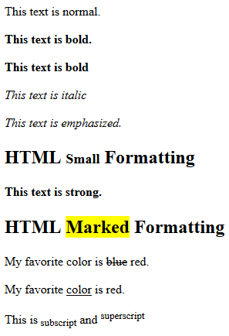
<!DOCTYPE html>
<html>
<body>
<p>This text is normal.</p>
<p><b>This text is bold.</b></p>
<p><b>This text is bold</b></p>
<p><i>This text is italic</i></p>
<p><em>This text is emphasized.</em></p>
<h2>HTML <small>Small</small> Formatting</h2>
<p><strong>This text is strong.</strong></p>
<h2>HTML <mark>Marked</mark> Formatting</h2>
<p>My favorite color is <del>blue</del> red.</p>
<p>My favorite <ins>color</ins> is red.</p>
<p>This is<sub> subscript</sub> and <sup>superscript</sup></p>
</body>
</html>

Slide 7
Tag | Description
<abbr> | Defines an abbreviation or acronym
<address> | Defines contact information for the author/owner of a document. <address> element is usually displayed in italic.
<bdo> | Defines the text direction. The <bdo> element is used to override the current text direction:
<blockquote> | Defines a section that is quoted from another source
<cite> | Defines the title of a work. Browsers usually display <cite> elements in italic.
<q> | Defines a short inline quotation

Slide 8
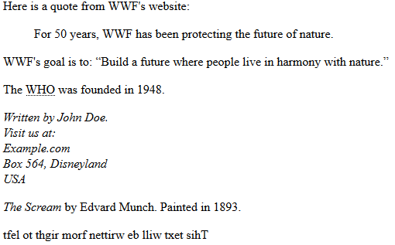
<!DOCTYPE html>
<html>
<body>
<p>Here is a quote from WWF's website:</p>
<blockquote cite="http://www.worldwildlife.org/who/index.html">
For 50 years, WWF has been protecting the future of nature.
</blockquote>
<p>WWF's goal is to: <q>Build a future where people live in harmony with nature.</q></p>
<p>The <abbr title="World Health Organization">WHO</abbr> was founded in 1948.</p>
<address>
Written by John Doe.<br>
Visit us at:<br>
Example.com<br>
Box 564, Disneyland<br>
USA
</address>
<p><cite>The Scream</cite> by Edvard Munch. Painted in 1893.</p>
<bdo dir="rtl">This text will be written from right to left</bdo>
</body>
</html>

Slide 9
You can add comments to your HTML source by using the following syntax:
      <!-- Write your comments here -->
      Notice that there is an exclamation point (!) in the opening
      tag, but not in the closing tag.
Comments are also great for debugging HTML, because you can comment out HTML lines of code, one at a time, to search for errors

Slide 10
CSS stands for Cascading Style Sheets.
CSS describes how HTML elements are to be displayed on screen, paper, or in other media.
CSS saves a lot of work. It can control the layout of multiple web pages all at once.
CSS can be added to HTML elements in 3 ways:
    Inline - by using the style attribute in HTML elements
    Internal - by using a <style> element in the <head> section
    External - by using an external CSS file
The most common way to add CSS, is to keep the styles in separate CSS files. However, here we will use inline and internal styling, because this is easier to demonstrate, and easier for you to try it yourself.

Slide 11


<!DOCTYPE html>
<html>
<body>
<h1 style="color:blue;">This is a Blue Heading</h1>
</body>
</html>

Slide 12

An internal CSS is used to define a style for a single HTML page.
An internal CSS is defined in the <head> section of an HTML page, within a <style> element
<!DOCTYPE html>
<html>
<head>
<style>
body {background-color: powderblue;}
h1 {color: blue;}
p {color: red;}
</style>
</head>
<body>
<h1>This is a heading</h1>
<p>This is a paragraph.</p>
</body>
</html>

Slide 13
An external style sheet is used to define style for many HTML pages.
With an external style sheet, you can change the look of an entire web site, by changing one file.
To use an external style sheet, add a link to it in the <head> section of the HTML page:
external css .html
<!DOCTYPE html>
<html>
<head>
<link rel="stylesheet" href="styles.css">
</head>
<body>
<h1>This is a heading</h1>
<p>This is a paragraph.</p>
</body>
</html>
styles.css
body {
background-color: powderblue;
}
h1 {
color: blue;
}
p {
color: red;
}

Slide 14
HTML links are hyperlinks.
You can click on a link and jump to another document.
In HTML, links are defined with the <a> tag
<a href="url">link text</a>
Example
<a href="https://www.google.com">Visit google</a>
Local Links
The example above used an absolute URL (A full web address).
A local link (link to the same web site) is specified with a relative URL (without http://www....).
Example
<a href="html_images.asp">HTML Images</a>

Slide 15
The target attribute specifies where to open the linked document. The target attribute can have one of the following values:
  _blank - Opens the linked document in a new window or tab
  _self - Opens the linked document in the same window/tab as it was clicked (this is default)
  _parent - Opens the linked document in the parent frame
  _top - Opens the linked document in the full body of the window
  framename - Opens the linked document in a named frame
HTML Links - Image as Link
  It is common to use images as links:
  Example
  <a href="default.asp“> Click me<img src="smiley.gif" alt=“image unload” style="width:42px;height:42px;border:0;">
  </a>
HTML Links - Create a Bookmark
HTML bookmarks are used to allow readers to jump to specific parts of a Web page. Bookmarks can be useful if your webpage is very long.
To make a bookmark, you must first create the bookmark, and then add a link to it. When the link is clicked, the page will scroll to the location with the bookmark.

Slide 16
HTML table is defined with the <table> tag.
Each table row is defined with the <tr> tag.
A table header is defined with the <th> tag. By default, table headings are bold and centered.
A table data/cell is defined with the <td> tag. The <td> elements are the data containers of the table. They can contain all sorts of HTML elements; text, images, lists, other tables, etc.
<!DOCTYPE html>
<html>
<body>
<table style="width:100%">
<tr>
<th>Firstname</th>
<th>Lastname</th>
<th>Age</th>
</tr>
<tr>
<td>Jill</td>
<td>Smith</td>
<td>50</td>
</tr>
<tr>
<td>Eve</td>
<td>Jackson</td>
<td>94</td>
</tr>
</table>
</body>
</html>

Slide 17
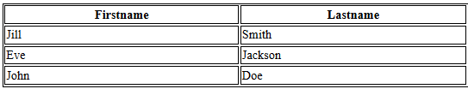
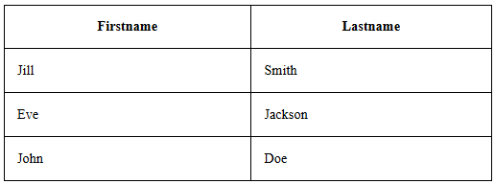
Adding a Border
If you do not specify a border for the table, it will be displayed without borders. A border is set using the CSS border property:
Example
table, th, td {
border: 1px solid black;
}
Collapsed Borders
If you want the borders to collapse into one border, add the CSS border-collapse property
Example
table, th, td {
border: 1px solid black;
border-collapse: collapse;
}

Slide 18
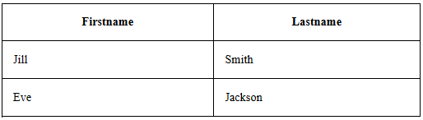
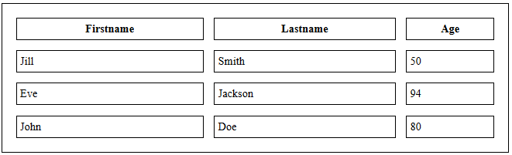
Adding Cell Padding
Cell padding specifies the space between the cell content and its borders.
If you do not specify a padding, the table cells will be displayed without padding.
To set the padding, use the CSS padding property:
Example
th, td {
padding: 15px;
}
Adding Border Spacing
Border spacing specifies the space between the cells.
To set the border spacing for a table, use the CSS border-spacing property:
Example
table {
border-spacing: 5px;
}

Slide 19
Cells that Span Many Columns
  To make a cell span more than one column, use the colspan attribute
  <table style="width:100%">
  <tr>
  <th>Name</th>
  <th colspan="2">Telephone</th>
  </tr>
  <tr>
  <td>Bill Gates</td>
  <td>55577854</td>
  <td>55577855</td>
  </tr>
  </table>

Slide 20

Cells that Span Many Rows
  To make a cell span more than one row, use the rowspan attribute
  <table style="width:100%">
  <tr>
  <th>Name:</th>
  <td>Bill Gates</td>
  </tr>
  <tr>
  <th rowspan="2">Telephone:</th>
  <td>55577854</td>
  </tr>
  <tr>
  <td>55577855</td>
  </tr>
  </table>

Slide 21

Class exercise

Slide 22

https://www.w3schools.com/html/default.asp
http://www.tutorialspoint.com/html/

